Slide 1


Data Science
32
BSIT · FALL 2026
From Foundations to Intelligent Systems
Six parts · 32 chapters · 16 weeks · four application domains
LECTURER
Dr. Mustafa Hameed
THE ISLAMIA UNIVERSITY OF BAHAWALPUR
Bahawalpur, Pakistan
Department of Information Technology · BSIT · Fall 2026
Notes:
Open the semester with this deck. It answers: what is this course, how is it sequenced, and how will I be assessed?

Slide 2
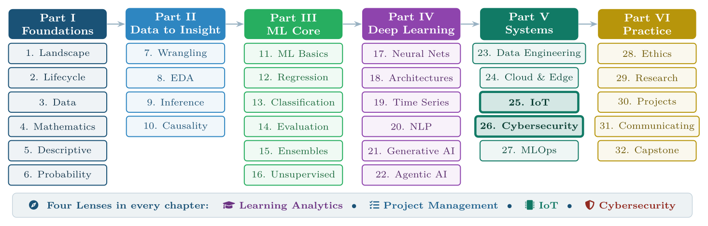
The whole course
FIGURE F.1
Course map. The six parts run left to right in the order they are taught; the chapters in each column are the order within that part. The four application lenses run beneath the whole course, appearing in every chapter.
Data Science · Course overview
Handout front matter 2
Notes:
Thirty-two chapters in six parts. The two application chapters the course is built towards are 25 and 26.
Figure F.1 (handout p. 0): Course map. The six parts run left to right in the order they are taught; the chapters in each column are the order within that part. The four application lenses run beneath the whole course, appearing in every chapter.

Slide 3





Four domains, every chapter
THE SPINE OF THE COURSE
LEARNING ANALYTICS
PROJECT MANAGEMENT
Who is at risk of failing, and what help actually helps.
Will this sprint land, and which estimates are systematically wrong.
INTERNET OF THINGS
CYBERSECURITY
Which machine is about to fail, decided on the device itself.
Which of two million events is the attack, within an analyst's budget.
Data Science · Course overview
Handout front matter 3
Notes:
Every chapter carries a Four Lenses panel. Students work in one of these domains for the capstone.

Slide 4
Foundations of Data
PART I
I
Before you can learn from data, you must know what data is, what it can and cannot tell you, and the small amount of mathematics that lets you say so precisely. Part I builds that ground floor.
CHAPTERS 1–6
Data Science · Course overview
Handout part opener 4
Notes:
Before you can learn from data, you must know what data is, what it can and cannot tell you, and the small amount of mathematics that lets you say so precisely. Part I builds that ground floor.

Slide 5
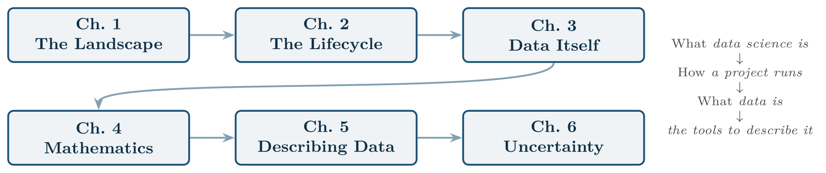
Reading path through Part I
FIGURE P1.1
Chapters 1–3 establish what the field is and what it works on; Chapters 4–6 supply the mathematical and statistical vocabulary used for the rest of the book.
Data Science · Course overview
Handout part opener 5
Notes:
Figure P1.1 (handout p. 2): Reading path through Part I. Chapters 1–3 establish what the field is and what it works on; Chapters 4–6 supply the mathematical and statistical vocabulary used for the rest of the book.

Slide 6
From Data to Insight
PART II
II
Most of a data scientist’s working life is spent here: making messy data usable, looking at it honestly, and being careful about what a sample is entitled to say about a population. No model can rescue a project that skipped this part.
CHAPTERS 7–10
Data Science · Course overview
Handout part opener 6
Notes:
Most of a data scientist’s working life is spent here: making messy data usable, looking at it honestly, and being careful about what a sample is entitled to say about a population. No model can rescue a project that skipped this part.

Slide 7
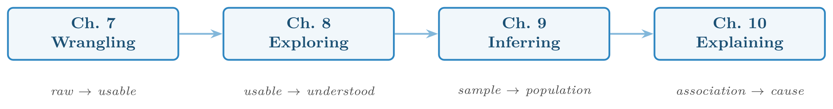
Reading path through Part II
FIGURE P2.1
Each chapter takes the data one step further from its raw state towards a defensible claim.
Data Science · Course overview
Handout part opener 7
Notes:
Figure P2.1 (handout p. 42): Reading path through Part II. Each chapter takes the data one step further from its raw state towards a defensible claim.

Slide 8
Machine Learning Core
PART III
III
Machine learning is the point where the course turns from describing data to learning from it. Note the order of the chapters: you learn to evaluate a model (Chapter 14) before you learn to build fancier ones (Chapters 15–16). That order is not an accident. Note the pace too: every algorithm here was already built from first principles in Machine Learning Fall 2026, taken immediately before this course, so this Part revises and applies rather than teaches from zero.
CHAPTERS 11–16
Data Science · Course overview
Handout part opener 8
Notes:
Machine learning is the point where the course turns from describing data to learning from it. Note the order of the chapters: you learn to evaluate a model (Chapter 14) before you learn to build fancier ones (Chapters 15–16). That order is not an accident. Note the pace too: every algorithm here was already built from first principles in Machine Learning Fall 2026, taken immediately before this course, so this Part revises and applies rather than teaches from zero.

Slide 9
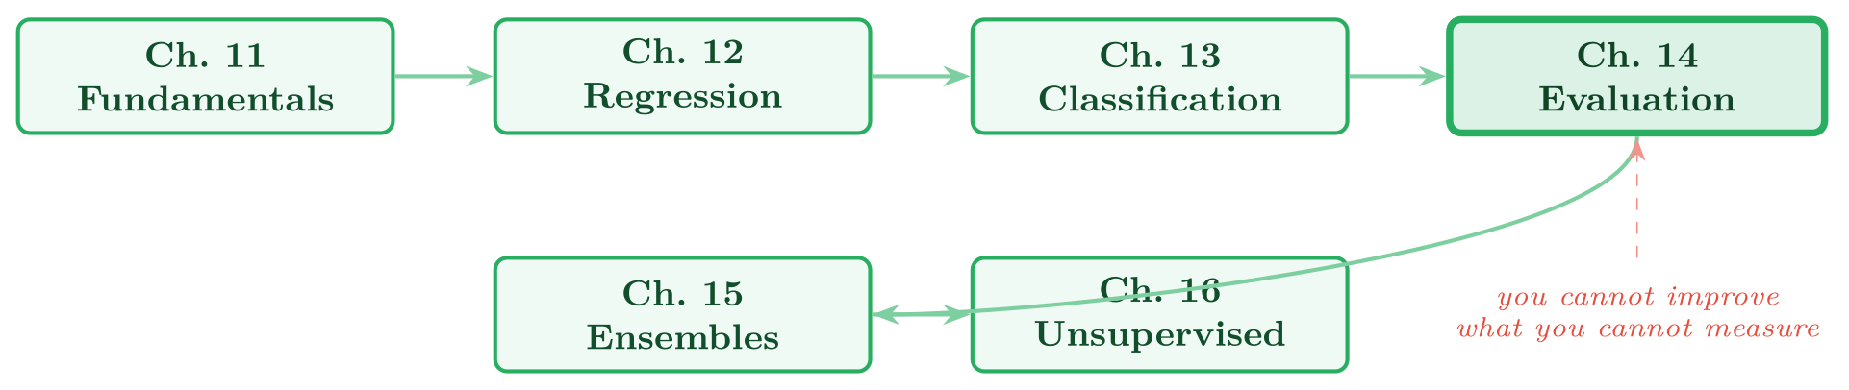
Reading path through Part III
FIGURE P3.1
Evaluation (Chapter 14, highlighted) is the hinge of the part: everything after it depends on being able to tell a good model from a lucky one.
Data Science · Course overview
Handout part opener 9
Notes:
Figure P3.1 (handout p. 69): Reading path through Part III. Evaluation (Chapter 14, highlighted) is the hinge of the part: everything after it depends on being able to tell a good model from a lucky one.

Slide 10
Deep Learning and Modern AI
PART IV
IV
Deep learning is not a different subject from Part III — it is the same supervised learning, with models flexible enough to learn their own features. Part IV follows that flexibility from a single neuron all the way to systems that write, reason and act.
CHAPTERS 17–22
Data Science · Course overview
Handout part opener 10
Notes:
Deep learning is not a different subject from Part III — it is the same supervised learning, with models flexible enough to learn their own features. Part IV follows that flexibility from a single neuron all the way to systems that write, reason and act.

Slide 11
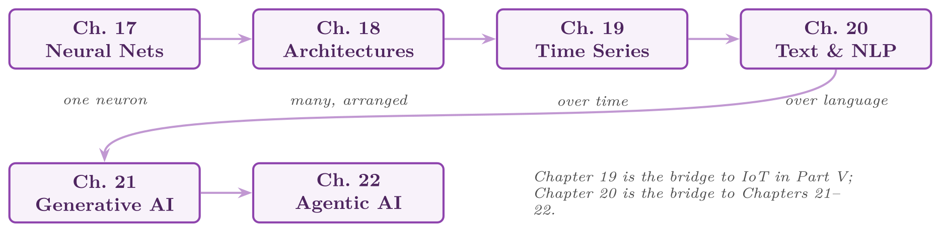
Reading path through Part IV
FIGURE P4.1
The sequence widens what a network sees: one input, then structured inputs, then inputs over time, then language — which is what makes generative and agentic systems possible.
Data Science · Course overview
Handout part opener 11
Notes:
Figure P4.1 (handout p. 108): Reading path through Part IV. The sequence widens what a network sees: one input, then structured inputs, then inputs over time, then language — which is what makes generative and agentic systems possible.

Slide 12
Data Science in Systems Context
PART V
V
A model in a notebook helps nobody. Part V is about data science as part of a running system — pipelines that feed it, infrastructure that hosts it, the two domains this course is built towards, and the operations discipline that keeps it correct after launch.
CHAPTERS 23–27
Data Science · Course overview
Handout part opener 12
Notes:
A model in a notebook helps nobody. Part V is about data science as part of a running system — pipelines that feed it, infrastructure that hosts it, the two domains this course is built towards, and the operations discipline that keeps it correct after launch.

Slide 13
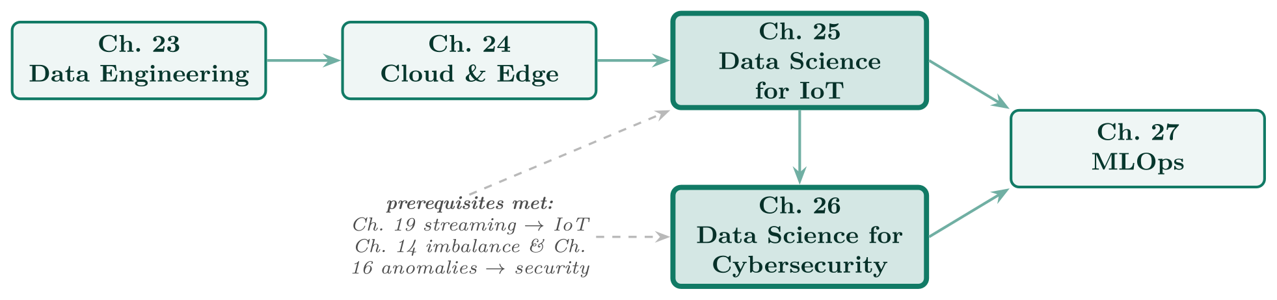
Reading path through Part V
FIGURE P5.1
Chapters 25 and 26 (highlighted) are the application chapters the whole course builds towards; the dashed arrows show the earlier chapters that make them possible.
Data Science · Course overview
Handout part opener 13
Notes:
Figure P5.1 (handout p. 149): Reading path through Part V. Chapters 25 and 26 (highlighted) are the application chapters the whole course builds towards; the dashed arrows show the earlier chapters that make them possible.

Slide 14
Professional Practice
PART VI
VI
Technical skill is the entry ticket, not the job. Part VI covers what separates a student who can fit a model from a professional who can be trusted with one: ethics, method, delivery, and the ability to make an audience understand.
CHAPTERS 28–32
Data Science · Course overview
Handout part opener 14
Notes:
Technical skill is the entry ticket, not the job. Part VI covers what separates a student who can fit a model from a professional who can be trusted with one: ethics, method, delivery, and the ability to make an audience understand.

Slide 15
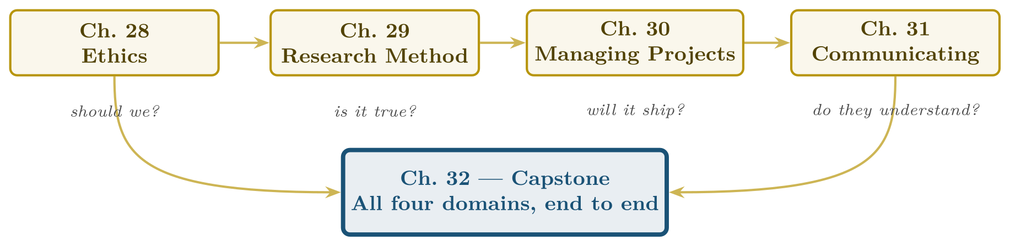
Reading path through Part VI
FIGURE P6.1
The four questions beneath the chapters are the ones a professional must answer about every piece of work; the capstone requires all four at once.
Data Science · Course overview
Handout part opener 15
Notes:
Figure P6.1 (handout p. 182): Reading path through Part VI. The four questions beneath the chapters are the ones a professional must answer about every piece of work; the capstone requires all four at once.

Slide 16

Sixteen weeks
THE TEACHING SCHEDULE
Wk | Lecture topic | Chapters | Lab | Assessment
1 | The landscape and the lifecycle | 1, 2 | Meet a dataset; write a frame | —
2 | Data and the mathematical toolkit | 3, 4 | Ten-minute audit; distance & descent | —
3 | Describing data; probability | 5, 6 | Centre, spread, shape; base-rate simulation | Quiz 1 (Ch 1–4)
4 | Wrangling and cleaning | 7 | Leak-proof pipeline | —
5 | Exploratory analysis | 8 | Standard EDA pass | Assignment 1 set
6 | Inference and causality | 9, 10 | Intervals, tests, confounder simulation | —
7 | ML fundamentals; regression (revision) | 11, 12 | Split, baseline, diagnose; fit & regularise | Assignment 1 due
8 | Classification; evaluation (revision) | 13, 14 | Five classifiers; evaluate honestly | —
9 | Features and ensembles; unsupervised (mostly revision) | 15, 16 | Engineer, ensemble, interpret; cluster & detect | Assignment 2 set
Data Science · Course overview
Handout Appendix G 16
Notes:
Do not read the table row by row: pick the row the room is most likely to get wrong and ask why.

Slide 17
Sixteen weeks (continued)
THE TEACHING SCHEDULE
Wk | Lecture topic | Chapters | Lab | Assessment
10 | Midterm examination | 1–16 | Midterm review workshop | Midterm (Ch 1–16)
11 | Neural networks and architectures | 17, 18 | Network from scratch; transfer learning | —
12 | Time series; text and NLP | 19, 20 | Decompose & walk-forward; TF-IDF classifier | Assignment 2 due
13 | Generative and agentic AI | 21, 22 | Minimal RAG; agent loop with guardrails | Quiz 2 (Ch 17–22)
14 | Data engineering; cloud and edge | 23, 24 | Data contracts; containerise a model | Capstone set
15 | Data science for IoT and cybersecurity | 25, 26 | Telemetry to alert; per-entity baselines & evasion test | —
16 | MLOps; ethics; practice & capstone | 27, 28, 29–32 | Monitored service; fairness measurement | Capstone due
Data Science · Course overview
Handout Appendix G 17
Notes:
Do not read the table row by row: pick the row the room is most likely to get wrong and ask why.

Slide 18
How the marks are earned
ASSESSMENT
Component | Weight | Covers | Assesses
Quiz 1 (week 3) | 5% | Ch 1–4 | Vocabulary and the analytics levels; a low-stakes early check
Assignment 1 (wk 5–7) | 15% | Ch 3, 5, 7, 8 | An audit and EDA on a messy dataset, with documented cleaning decisions
Midterm (week 10) | 20% | Ch 1–16 | Conceptual understanding; hand calculations; framing a stated problem
Assignment 2 (wk 9–12) | 20% | Ch 11–16 | A complete supervised project with baseline, correct validation and cost-based threshold
Quiz 2 (week 13) | 5% | Ch 17–22 | Architectures, generative and agentic concepts
Capstone (wk 14–16) | 35% | All | The four deliverables of Chapter 32, marked on that chapter’s rubric
Data Science · Course overview
Handout Appendix G 18
Notes:
Do not read the table row by row: pick the row the room is most likely to get wrong and ask why.

Slide 19
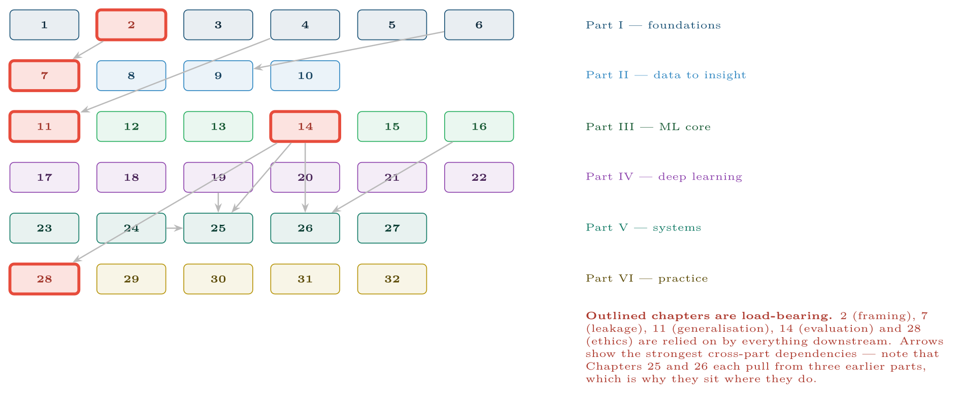
Chapter dependency map
FIGURE G.1
The outlined chapters cannot be skipped; the arrows show why Chapters 25 and 26 are placed in Part V rather than earlier.
Data Science · Course overview
Handout Appendix G 19
Notes:
Figure G.1 (handout p. 242): Chapter dependency map. The outlined chapters cannot be skipped; the arrows show why Chapters 25 and 26 are placed in Part V rather than earlier.

Slide 20

If You Must Cut Something
WATCH OUT
Cut depth, never Chapter 14. Evaluation is the hinge of the whole course: a student who cannot evaluate honestly will misreport every subsequent result. If time is short, compress Chapters 18 and 20–22 — they are the most self-contained — and protect Chapters 2, 7, 11, 14 and 28, which everything else depends on.
Data Science · Course overview
Handout Appendix G 20
Notes:
Read the box aloud, then ask for an example from the room before moving on.

Slide 21
We start with Chapter 1
01
FIRST SESSION
BRING
Chapter 1 — The Data Science Landscape
A laptop with Python, and the handout
FIRST LAB
READ BEFORE WEEK 2
Meet a dataset; write a frame
Chapters 1 and 2
Data Science · Course overview
21
Notes:
Close the first session here.

